Slide 1




































Data Analysis and Analytics

Slide 2


Introduction
Data analysis and analytics have become integral to decision-making in various fields.
In this presentation, we'll explore the
importance, |  | process, | and
applications | of | data analysis | and
analytics.

Slide 3
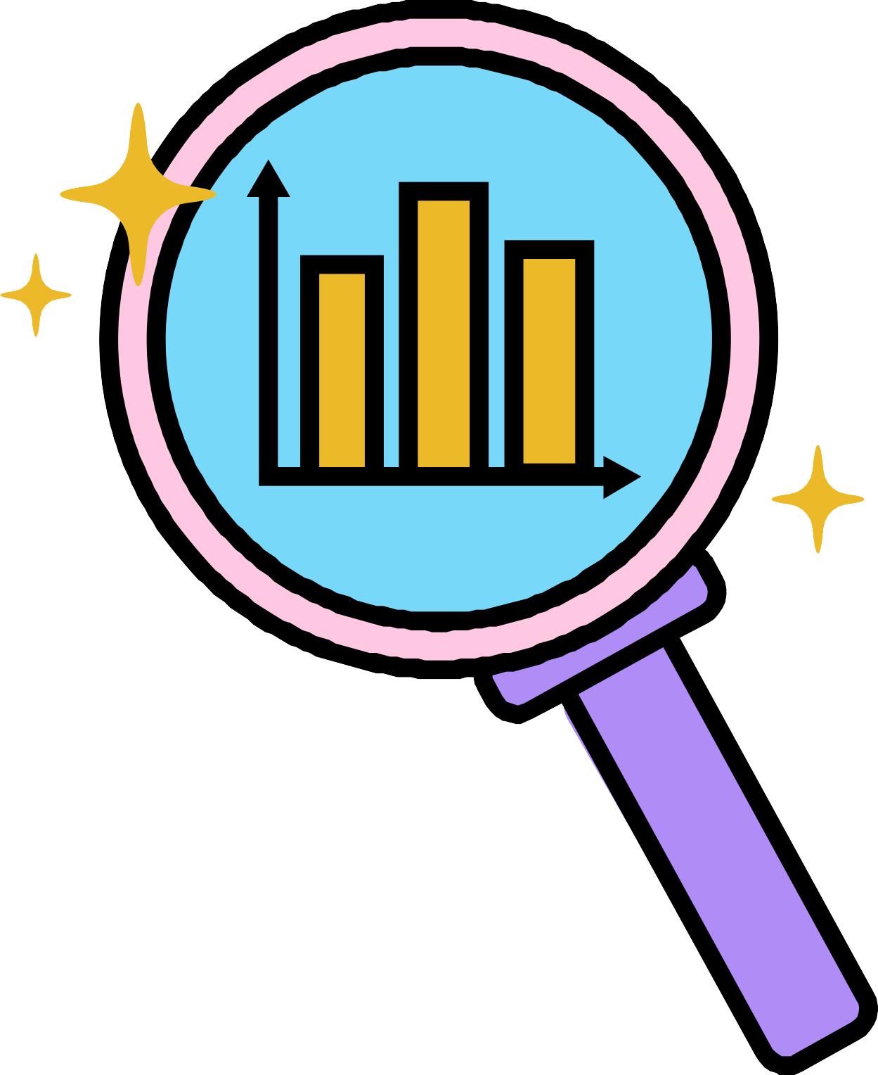

Understanding Data Analysis
Data analysis involves examining, cleaning, transforming, and modeling data.
It helps uncover insights, trends, and patterns that inform decision-making. Types of data analysis: descriptive, diagnostic, predictive, and prescriptive.

Slide 4
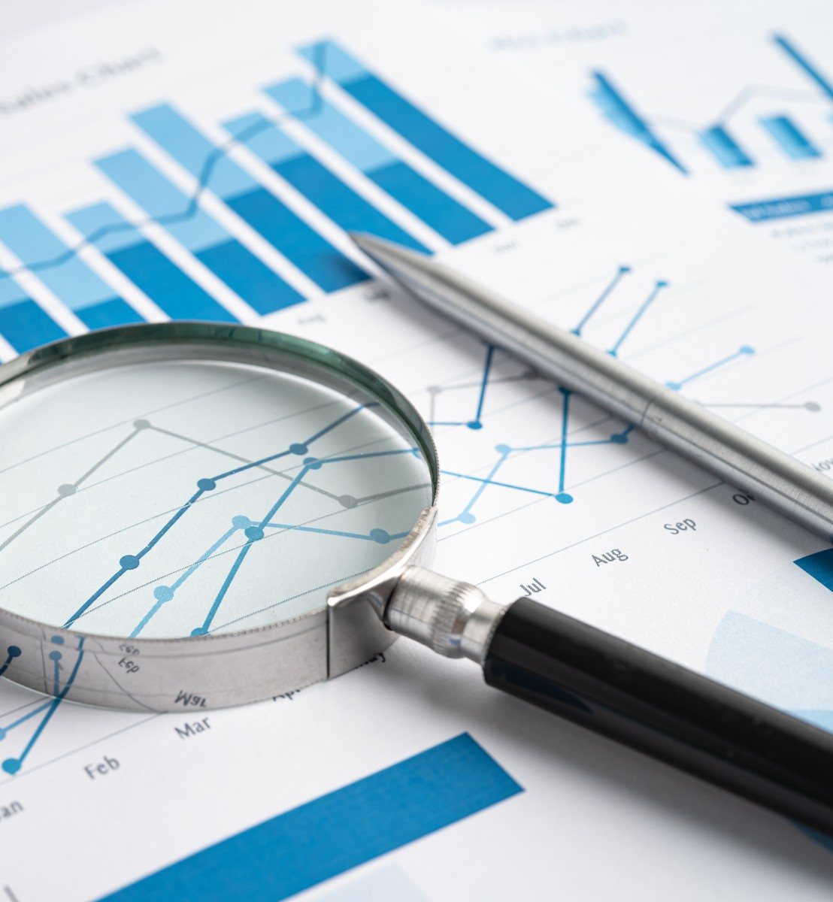
Importance of Data Analysis
Informed Decision-Making: Businesses rely on data to make strategic decisions.
Competitive Advantage: Analyzing data can provide a competitive edge by identifying opportunities and threats.
Problem Solving: Data analysis helps solve complex problems and optimize processes.
Personalization: Enables personalized experiences for customers through understanding their behavior.

Slide 5
Data Analytics Process
Data Collection
Gathering relevant data from various sources.
Structured and unstructured data.
Data Cleaning and Preprocessing
Removing errors, inconsistencies, and duplicates.
Transforming data into a usable format.
Data Exploration
Visualizing and summarizing data to understand its characteristics.
Identifying outliers and trends.
Data Modeling
Creating statistical and machine learning models to make predictions.
Training and testing models for accuracy.
Interpretation and Communication
Analyzing model results and drawing meaningful insights.
Communicating findings to stakeholders through reports and visualizations.

Slide 6
Applications of Data Analytics
Business Intelligence:
Market analysis, customer segmentation, and sales forecasting.
Healthcare:
Predictive modeling for disease outbreaks, patient diagnosis, and personalized treatment.
Finance:
Risk assessment, fraud detection, and algorithmic trading.
Marketing:
Campaign effectiveness, sentiment analysis, and customer behavior prediction.
Social Sciences:
Studying human behavior, social trends, and public opinion.

Slide 7

Challenges in Data Analysis
Data Privacy: Ensuring compliance with regulations like GDPR.
Data Quality: Dealing with incomplete, inaccurate, or inconsistent data.
Scalability: Analyzing large datasets efficiently.
Skill Gap: The need for skilled data analysts and data scientists.

Slide 8
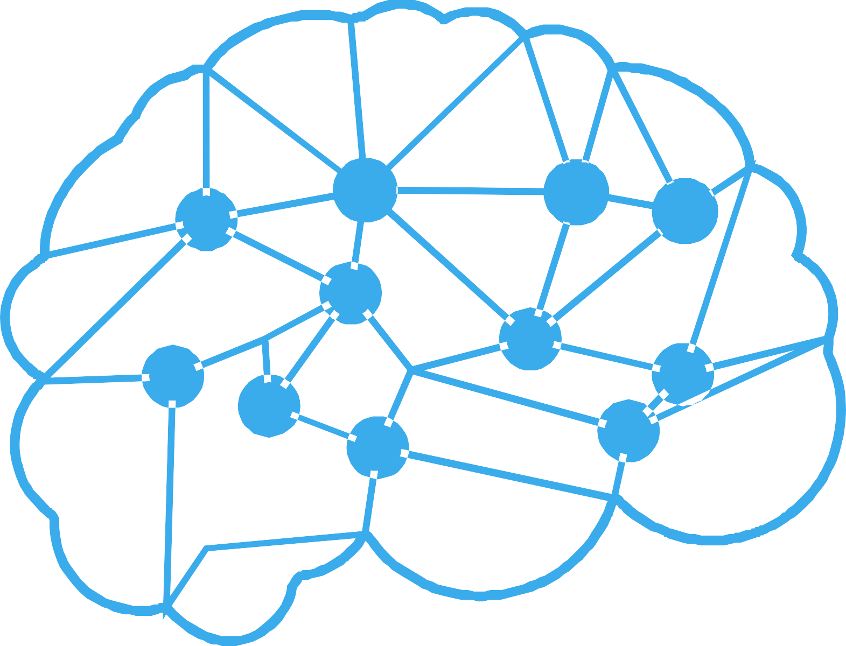

Future Trends
Artificial Intelligence and Machine Learning Integration.
Real-time data analysis and IoT applications.
Ethical considerations in data
analysis.

Slide 9
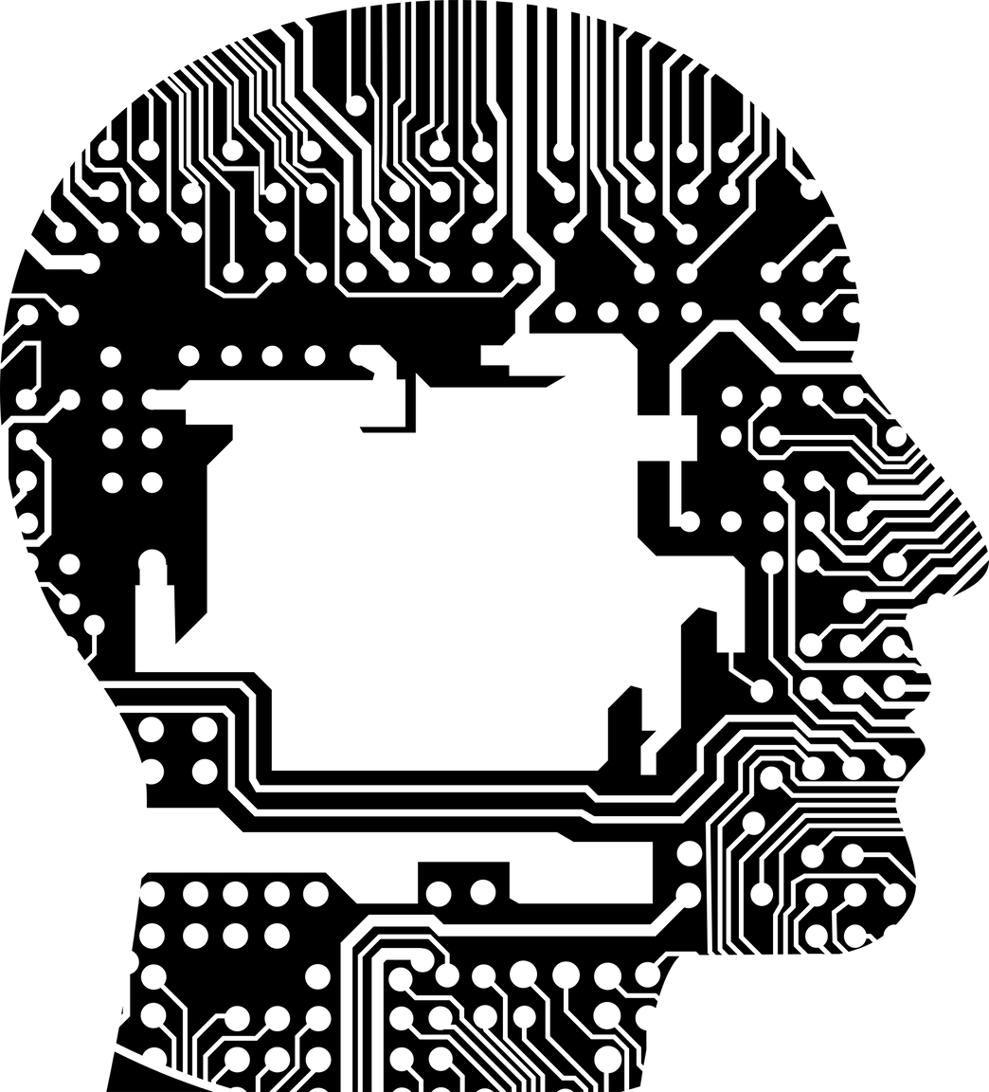
Conclusion
Data analysis and analytics empower us to make informed decisions in various domains. Understanding the process and applications can lead to improved problem-solving and innovation.
As technology advances, the field of data analysis continues to evolve, offering exciting possibilities for the future.

Slide 10


Do you have any questions?

